Slide 1
Unit II
Bandwidth Utilization and
Transmission Media
1
Notes:
Data Communication

Slide 2
Introduction
Bandwidth utilization is the wise use of available bandwidth to achieve specific goals.
Efficiency can be achieved by multiplexing;
Privacy and anti-jamming can be achieved by spreading.
2
Notes:
Data Communication

Slide 3
MULTIPLEXING
Whenever the bandwidth of a medium linking two devices is greater than the bandwidth needs of the devices, the link can be shared.
Multiplexing is the set of techniques that allows the simultaneous transmission of multiple signals across a single data link.
Need - As data and telecommunications use increases, traffic is increasing.
We can accommodate this increase by continuing to add individual links each time a new channel is needed; or we can install higher-bandwidth links and use each to carry multiple signals.
3
Notes:
Data Communication

Slide 4
MULTIPLEXING
Today's technology includes high-bandwidth media such as optical fiber and terrestrial and satellite microwaves.
Each has a bandwidth far in excess of that needed for the average transmission signal.
If the bandwidth of a link is greater than the bandwidth needs of the devices connected to it, the bandwidth is wasted.
An efficient system maximizes the utilization of all resources; bandwidth is one of the most precious resources we have in data communications.
4
Notes:
Data Communication

Slide 5
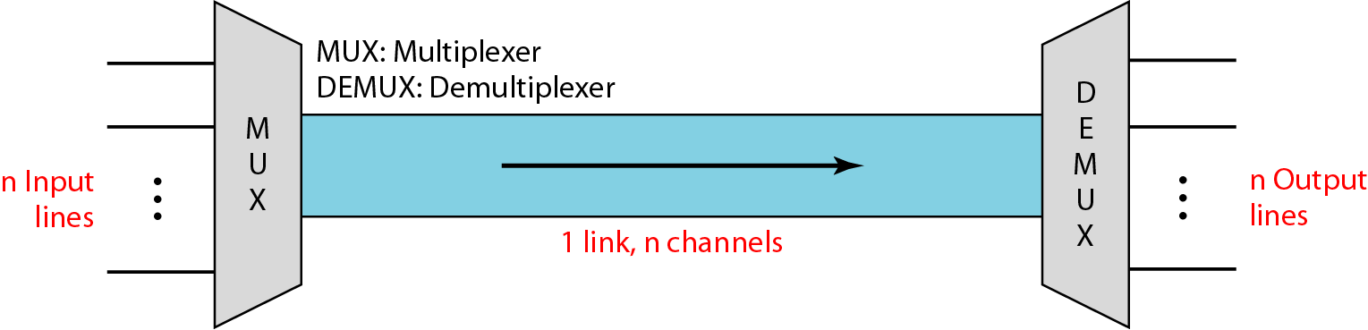
MULTIPLEXING
In a multiplexed system, n lines share the bandwidth of one link.
Figure shows the basic format of a multiplexed system.
Figure : Dividing a link into channels
5
Notes:
Data Communication

Slide 6
MULTIPLEXING
The lines on the left direct their transmission streams to a multiplexer (MUX), which combines them into a single stream (many-to-one).
At the receiving end, that stream is fed into a demultiplexer (DEMUX), which separates the stream back into its component transmissions (one-to-many) and directs them to their corresponding lines.
In the figure, the word link refers to the physical path.
The word channel refers to the portion of a link that carries a transmission between a given pair of lines.
One link can have many (n) channels
6
Notes:
Data Communication

Slide 7
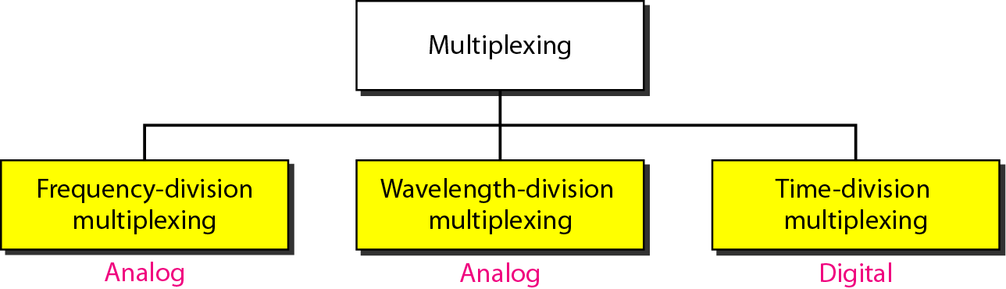


Basic Multiplexing Techniques:
The first two are techniques designed for analog signals, the third, for digital signals.
7
Notes:
Data Communication

Slide 8










Frequency-Division Multiplexing (FDM)
FDM is an analog technique that can be applied when the bandwidth of a link (in hertz) is greater than the combined bandwidths of the signals to be transmitted.
In FDM, signals generated by each sending device modulate different carrier frequencies.
These modulated signals are then combined into a single composite signal that can be transported by the link.
Carrier frequencies are separated by sufficient bandwidth to accommodate the modulated signal.
These bandwidth ranges are the channels through which the various signals travel.
8
Notes:
Data Communication

Slide 9
Frequency-Division Multiplexing (FDM)
Channels can be separated by strips of unused bandwidth guard bands to prevent signals from overlapping.
In addition, carrier frequencies must not interfere with the original data frequencies
In the figure, the transmission path is divided into three parts, each representing a channel that carries one transmission
9
Notes:
Data Communication

Slide 10
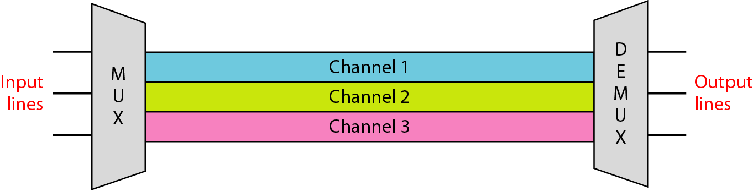
Frequency-Division Multiplexing (FDM)
10
Notes:
Data Communication

Slide 11
Frequency-Division Multiplexing (FDM)
We consider FDM to be an analog multiplexing technique; however, this does not mean that FDM cannot be used to combine sources sending digital signals.
A digital signal can be converted to an analog signal before FDM is used to multiplex them.
11
Notes:
Data Communication

Slide 12
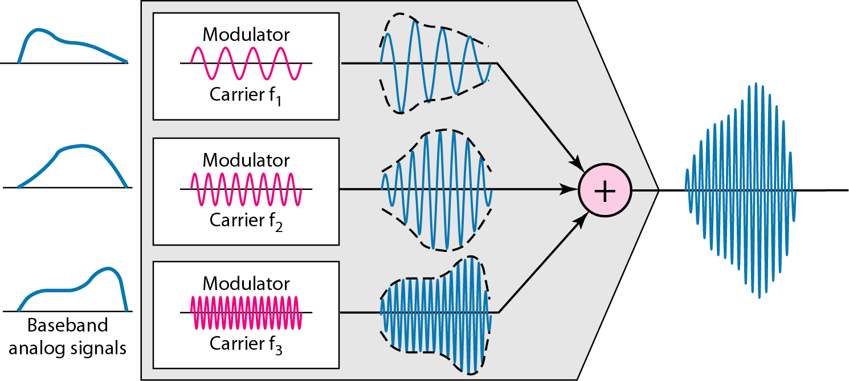
Multiplexing Process
Figure is a conceptual illustration of the multiplexing process.
12
Notes:
Data Communication

Slide 13
Multiplexing Process
Each source generates a signal of a similar frequency range.
Inside the multiplexer, these similar signals modulates different carrier frequencies (f₁, f₂, and f₃).
The resulting modulated signals are then combined into a single composite signal that is sent out over a media link that has enough bandwidth to accommodate it.
13
Notes:
Data Communication

Slide 14
Demultiplexing Process
The demultiplexer uses a series of filters to decompose the multiplexed signal into its constituent component signals.
The individual signals are then passed to a demodulator that separates them from their carriers and passes them to the output lines.
14
Notes:
Data Communication

Slide 15
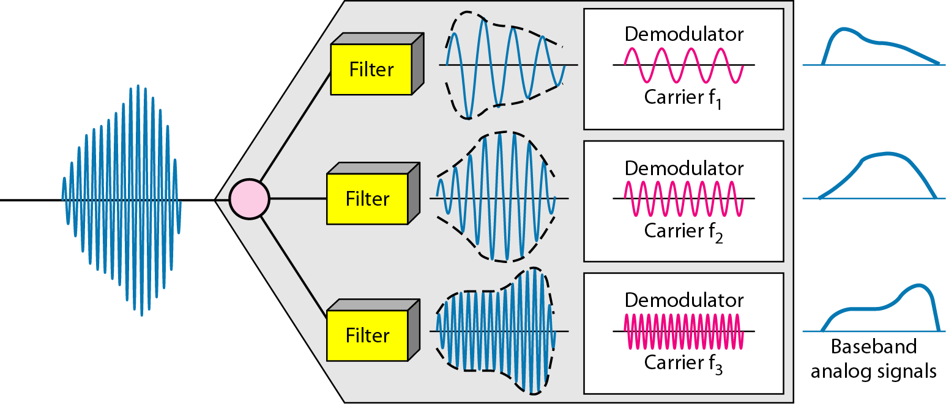
Demultiplexing Process
15
Notes:
Data Communication

Slide 16
Assume that a voice channel occupies a bandwidth of 4 kHz. We need to combine three voice channels into a link with a bandwidth of 12 kHz, from 20 to 32 kHz. Show the configuration, using the frequency domain. Assume there are no guard bands.
16
Notes:
Data Communication

Slide 17
Assume that a voice channel occupies a bandwidth of 4 kHz. We need to combine three voice channels into a link with a bandwidth of 12 kHz, from 20 to 32 kHz. Show the configuration, using the frequency domain. Assume there are no guard bands.
Solution
We shift (modulate) each of the three voice channels to a different bandwidth, as shown in Figure (MUX).
We use the 20- to 24-kHz bandwidth for the first channel, the 24- to 28-kHz bandwidth for the second channel, and the 28- to 32-kHz bandwidth for the third one.
Then we combine them as shown in Figure (DEMUX).
17
Notes:
Data Communication

Slide 18
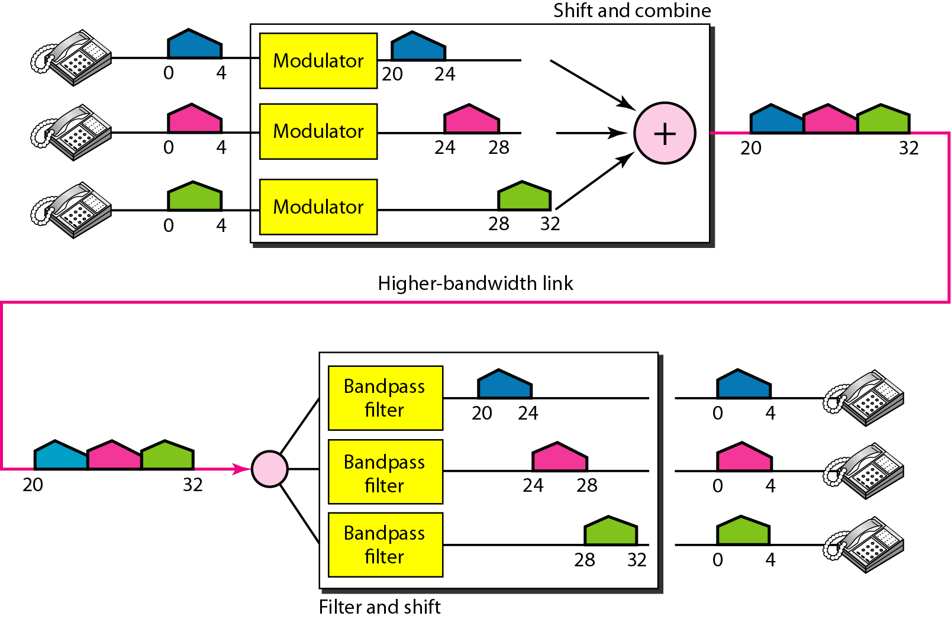
18
Notes:
Data Communication

Slide 19
Five channels, each with a 100-kHz bandwidth, are to be multiplexed together. What is the minimum bandwidth of the link if there is a need for a guard band of 10 kHz between the channels to prevent interference?
19
Notes:
Data Communication

Slide 20
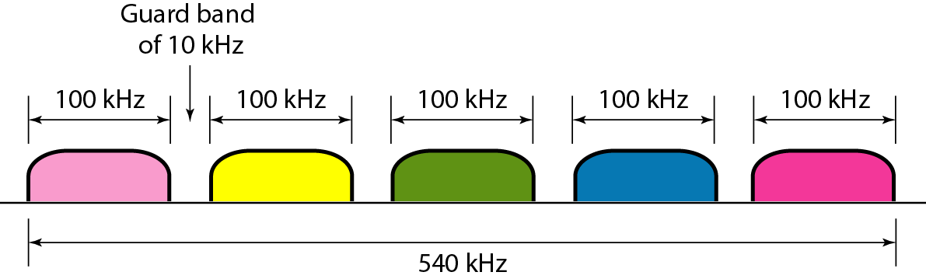
Five channels, each with a 100-kHz bandwidth, are to be multiplexed together. What is the minimum bandwidth of the link if there is a need for a guard band of 10 kHz between the channels to prevent interference?
Solution
For five channels, we need at least four guard bands.
This means that the required bandwidth is at least
5 × 100 + 4 × 10 = 540 kHz, As shown in Figure
20
Notes:
Data Communication

Slide 21
The Analog Carrier System
To maximize the efficiency of their infrastructure, telephone companies have traditionally multiplexed signals from lower-bandwidth lines onto higher-bandwidth lines.
In this way, many switched or leased lines can be combined into fewer but bigger channels.
For analog lines, FDM is used.
One of these hierarchical systems used by AT&T is made up of groups, supergroups, master groups, and jumbo groups (see Figure)
21
Notes:
Data Communication

Slide 22
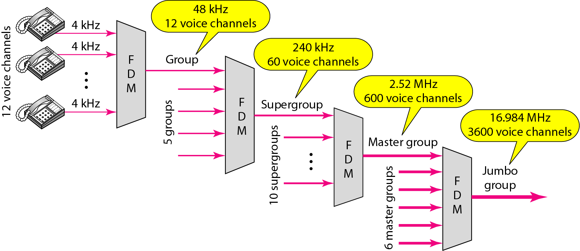
The Analog Carrier System
22
Notes:
Data Communication

Slide 23
The Analog Carrier System
In this analog hierarchy, 12 voice channels are multiplexed onto a higher-bandwidth line to create a group.
A group has 48 kHz of bandwidth and supports 12 voice channels.
At the next level, up to five groups can be multiplexed to create a composite signal called a supergroup.
A supergroup has a bandwidth of 240 kHz and supports up to 60 voice channels.
Supergroups can be made up of either five groups or 60 independent voice channels.
23
Notes:
Data Communication

Slide 24
The Analog Carrier System
At the next level, 10 supergroups are multiplexed to create a master group.
A master group must have 2.40 MHz of bandwidth, but the need for guard bands between the supergroups increases the necessary bandwidth to 2.52 MHz.
Master groups support up to 600 voice channels
24
Notes:
Data Communication

Slide 25
The Analog Carrier System
Finally, six master groups can be combined into a jumbo group.
A jumbo group must have 15.12 MHz (6 x 2.52 MHz) but is augmented to 16.984 MHz to allow for guard bands between the master groups.
25
Notes:
Data Communication

Slide 26
Other Applications of FDM
A very common application of FDM is AM and FM radio broadcasting.
Radio uses the air as the transmission medium.
A special band from 530 to 1700 kHz is assigned to AM radio.
All radio stations need to share this band.
Each AM station needs 10kHz of bandwidth.
Each station uses a different carrier frequency, which means it is shifting its signal and multiplexing.
The signal that goes to the air is a combination of signals.
26
Notes:
Data Communication

Slide 27
Other Applications of FDM
A receiver receives all these signals, but filters (by tuning) only the one which is desired.
Without multiplexing, only one AM station could broadcast to the common link, the air.
However, we need to know that there is physical multiplexer or demultiplexer here.
Multiplexing is done at the data link layer.
The situation is similar in FM broadcasting. However, FM has a wider band of 88 to 108 MHz because each station needs a bandwidth of 200 kHz
27
Notes:
Data Communication

Slide 28
Other Applications of FDM
Another common use of FDM is in television broadcasting.
Each TV channel has its own bandwidth of 6 MHz.
28
Notes:
Data Communication

Slide 29
Other Applications of FDM
1G of cellular telephones (still in operation) also uses FDM.
Each user is assigned two 30-kHz channels, one for sending voice and the other for receiving.
29
Notes:
Data Communication

Slide 30
Wavelength-Division Multiplexing
WDM is designed to use the high-data-rate capability of fiber-optic cable.
The optical fiber data rate is higher than the data rate of metallic transmission cable.
Using a fiber-optic cable for one single line wastes the available bandwidth.
Multiplexing allows us to combine several lines into one.
30
Notes:
Data Communication

Slide 31
Wavelength-Division Multiplexing
WDM is conceptually the same as FDM, except that the multiplexing and demultiplexing involve optical signals transmitted through fiber-optic channels.
The idea is the same:
We are combining different signals of different frequencies.
The difference is that the frequencies are very high.
31
Notes:
Data Communication

Slide 32
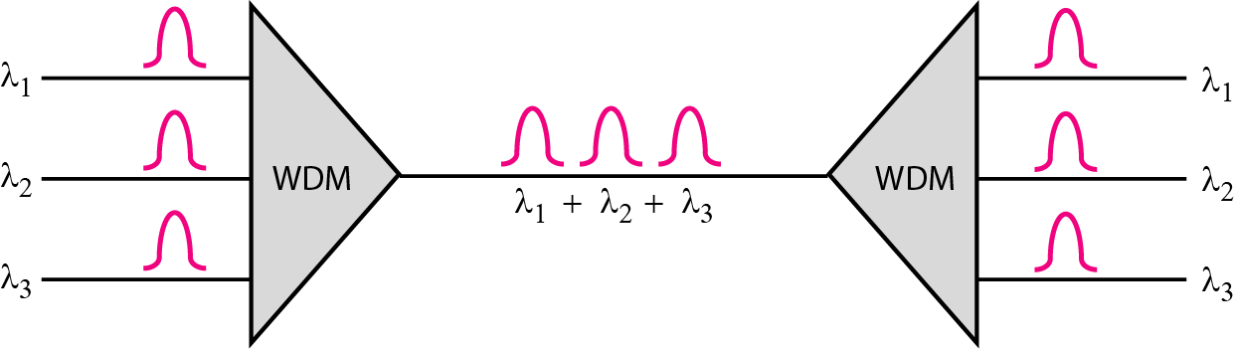
Wavelength-Division Multiplexing
32
Notes:
Data Communication

Slide 33
Wavelength-Division Multiplexing
Very narrow bands of light from different sources are combined to make a wider band of light.
At the receiver, the signals are separated by the demultiplexer.
WDM is an analog multiplexing technique to combine optical signals.
33
Notes:
Data Communication

Slide 34
Wavelength-Division Multiplexing
We want to combine multiple light sources into one single light at the multiplexer and do the reverse at the demultiplexer.
The combining and splitting of light sources are easily handled by a prism.
Recall from basic physics that a prism bends a beam of light based on the angle of incidence and the frequency.
34
Notes:
Data Communication

Slide 35
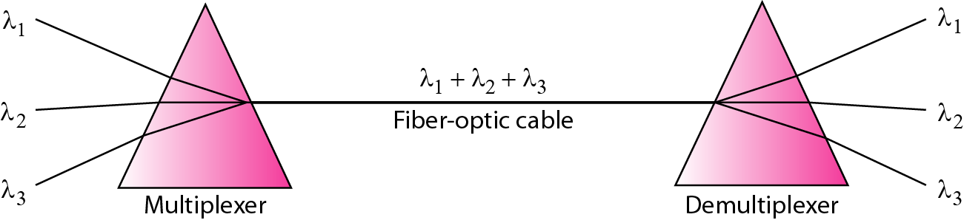
Wavelength-Division Multiplexing
Using this technique, a multiplexer can be made to combine several input beams of light, each containing a narrow band of frequencies, into one output beam of a wider band of frequencies.
A demultiplexer can also be made to reverse the process.
35
Notes:
Data Communication

Slide 36
Wavelength-Division Multiplexing
One application of WDM is the SONET network in which multiple optical fiber lines are multiplexed and demultiplexed.
A new method, called Dense WDM (DWDM), can multiplex a very large number of channels by spacing channels very close to one another.
It achieves even greater efficiency.
36
Notes:
Data Communication

Slide 37
Time-Division Multiplexing (TDM)
TDM is a digital process that allows several connections to share the high bandwidth of a link
Instead of sharing a portion of the bandwidth as in FDM, time is shared.
Each connection occupies a portion of time in the link
37
Notes:
Data Communication

Slide 38
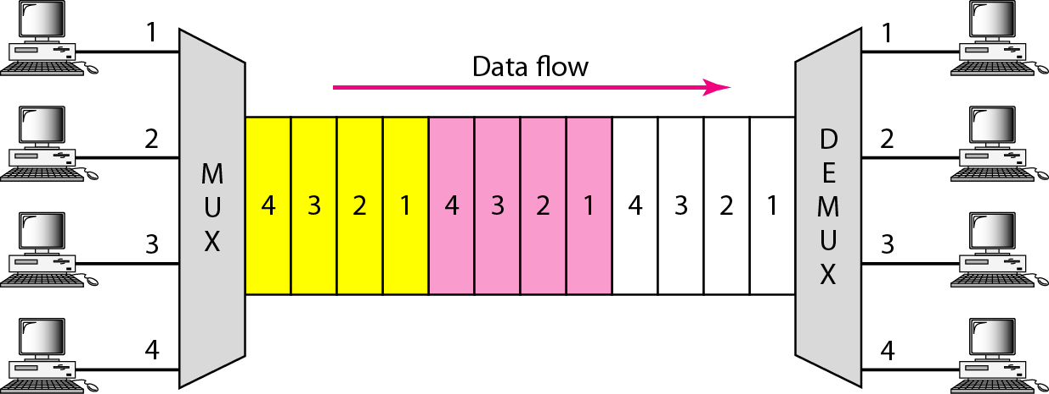
Time-Division Multiplexing (TDM)
In the figure, portions of signals 1,2,3, and 4 occupy the link sequentially.
38
Notes:
Data Communication

Slide 39
Time-Division Multiplexing (TDM)
The delivery is fixed and unvarying, unlike switching.
TDM is, in principle, a digital multiplexing technique.
Digital data from different sources are combined into one timeshared link.
TDM is a digital multiplexing technique for combining several low-rate channels into one high-rate one.
39
Notes:
Data Communication

Slide 40
Time-Division Multiplexing (TDM)
However, this does not mean that the sources cannot produce analog data; analog data can be sampled, changed to digital data, and then multiplexed by using TDM.
We can divide TDM into two different schemes: synchronous and statistical.
In synchronous TDM, each input connection has an allotment in the output even if it is not sending data.
40
Notes:
Data Communication

Slide 41
Time Slots and Frames
In synchronous TDM, the data flow of each input connection is divided into units, where each input occupies one input time slot.
A unit can be 1 bit, one character, or one block of data.
Each input unit becomes one output unit and occupies one output time slot.
However, the duration of an output time slot is n times shorter than the duration of an input time slot.
If an input time slot is T s, the output time slot is T/n s, where n is the number of connections.
41
Notes:
Data Communication

Slide 42
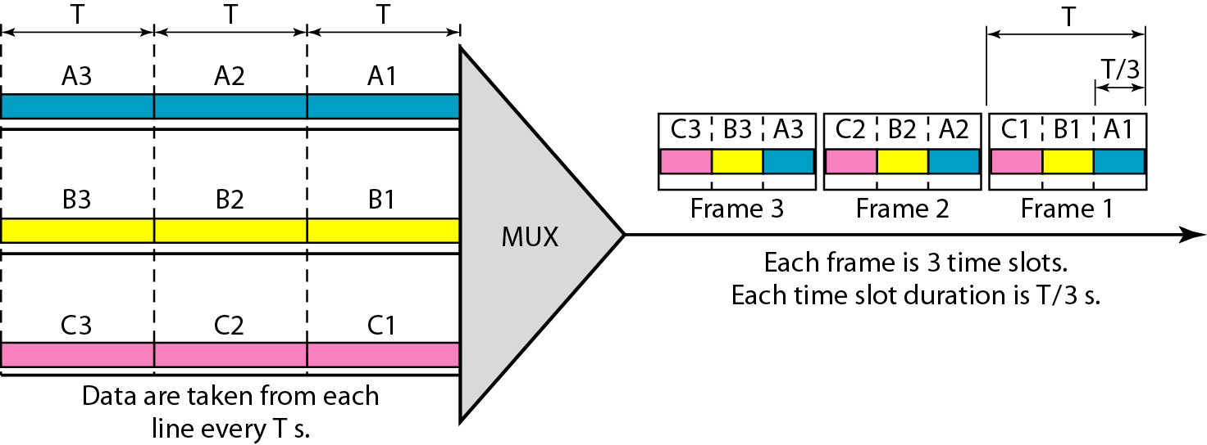
Time Slots and Frames
A unit in the output connection has a shorter duration; it travels faster
Figure shows an example of synchronous TDM where n is 3.
42
Notes:
Data Communication

Slide 43
Time Slots and Frames
In synchronous TDM, a round of data units from each input connection is collected into a frame
If we have n connections, a frame is divided into n time slots and one slot is allocated for each unit, one for each input line.
If the duration of the input unit is T, the duration of each slot is T/n and the duration of each frame is T.
The data rate of the output link must be n times the data rate of a connection to guarantee the flow of data.
43
Notes:
Data Communication

Slide 44
Interleaving
TDM can be visualized as two fast-rotating switches, one on the multiplexing side and the other on the demultiplexing side.
The switches are synchronized and rotate at the same speed, but in opposite directions.
On the multiplexing side, as the switch opens in front of a connection, that connection has the opportunity to send a unit onto the path.
This process is called interleaving.
On the demultiplexing side, as the switch opens in front of a connection, that connection has the opportunity to receive a unit from the path.
44
Notes:
Data Communication

Slide 45
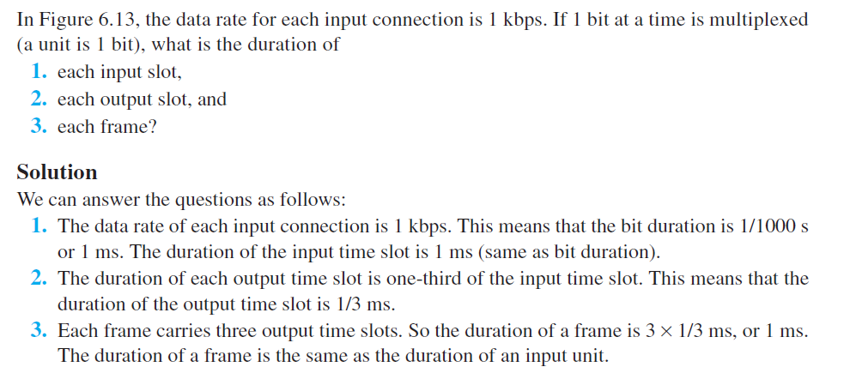
Example

Slide 46
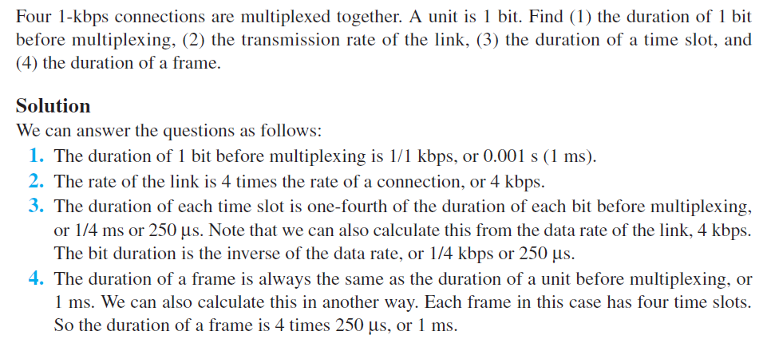
Example

Slide 47
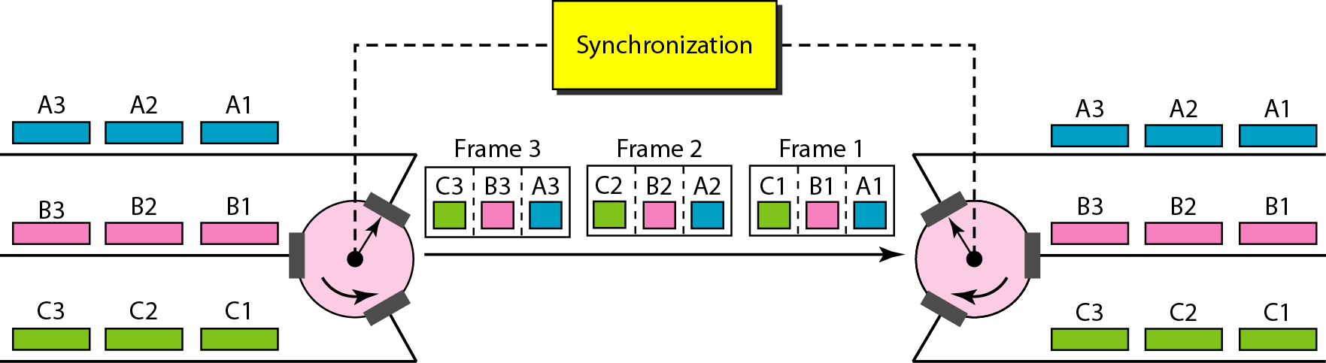
Interleaving
Figure shows the interleaving process .
In this figure, we assume that no switching is involved and that the data from the first connection at the multiplexer site go to the first connection at the demultiplexer
47
Notes:
Data Communication

Slide 48
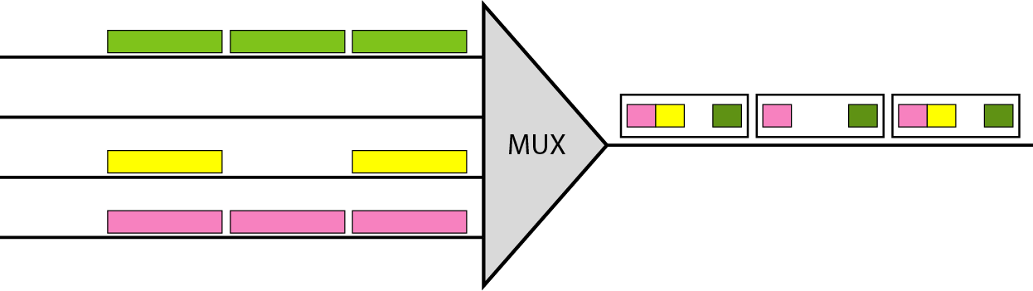
Empty Slots
Synchronous TDM is not as efficient as it could be.
If a source does not have data to send, the corresponding slot in the output frame is empty.
Figure shows a case in which one of the input lines has no data to send and one slot in another input line has discontinuous data.
48
Notes:
Data Communication

Slide 49
Empty Slots
The first output frame has three slots filled, the second frame has two slots filled, and the third frame has three slots filled.
No frame is full.
Statistical TDM can improve the efficiency by removing the empty slots from the frame.
49
Notes:
Data Communication

Slide 50
Data Rate Management
One problem with TDM is how to handle a disparity in the input data rates.
In all our discussion so far, we assumed that the data rates of all input lines were the same.
However, if data rates are not the same, three strategies, or a combination of them, can be used.
We call these three strategies multilevel multiplexing, multiple-slot allocation, and pulse stuffing.
50
Notes:
Data Communication

Slide 51
Multilevel Multiplexing
Multilevel multiplexing is a technique used when the data rate of an input line is a multiple of others.
For example, in Figure, we have two inputs of 20 kbps and three inputs of 40 kbps.
The first two input lines can be multiplexed together to provide a data rate equal to the last three.
A second level of multiplexing can create an output of 160 kbps.
51
Notes:
Data Communication

Slide 52
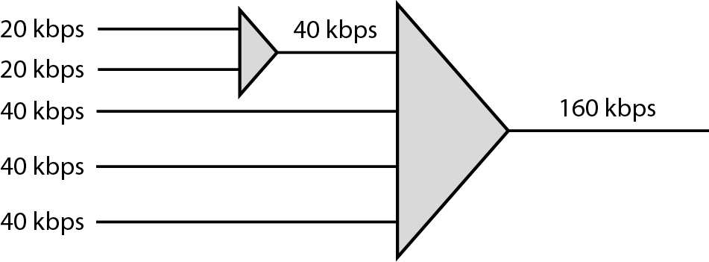
Multilevel Multiplexing
Multilevel multiplexing is a technique used when the data rate of an input line is a multiple of others.
For example, in Figure, we have two inputs of 20 kbps and three inputs of 40 kbps.
52
Notes:
Data Communication

Slide 53
Multilevel Multiplexing
The first two input lines can be multiplexed together to provide a data rate equal to the last three.
A second level of multiplexing can create an output of 160 kbps.
Multiple-Slot Allocation
Sometimes it is more efficient to allot more than one slot in a frame to a single input line.
For example, we might have an input line that has a data rate that is a multiple of another input.
53
Notes:
Data Communication

Slide 54
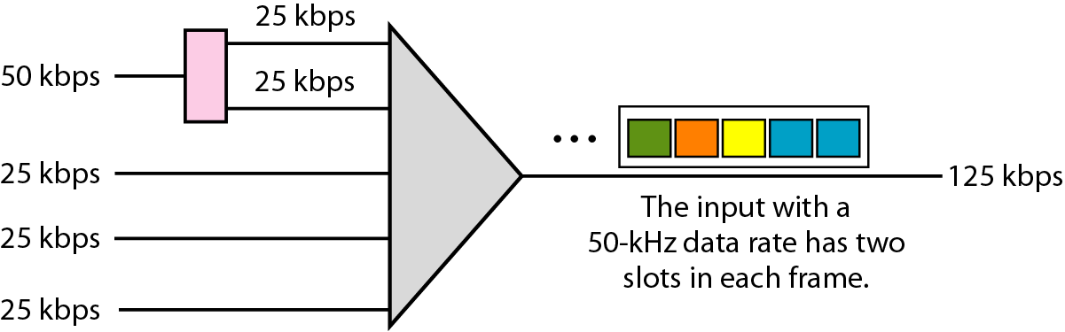
Multiple-Slot Allocation
In Figure, the input line with a 50 kbps data rate can be given two slots in the output.
We insert a serial-to-parallel converter in the line to make two inputs out of one.
54
Notes:
Data Communication

Slide 55
Pulse Stuffing
Sometimes the bit rates of sources are not multiple integers of each other.
Therefore, neither of the above two techniques can be applied.
One solution is to make the highest input data rate the dominant data rate and then add dummy bits to the input lines with lower rates.
This will increase their rates.
This technique is called pulse stuffing, bit padding, or bit stuffing.
55
Notes:
Data Communication

Slide 56
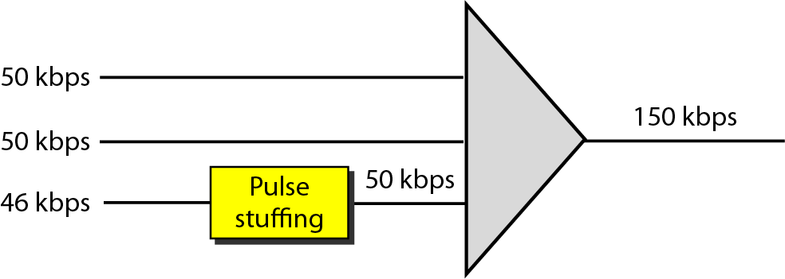
Pulse Stuffing
The idea is shown in Figure 6.21.
The input with a data rate of 46 is pulse-stuffed to increase the rate to 50 kbps.
Now multiplexing can take place.
56
Notes:
Data Communication

Slide 57
Frame Synchronizing
The implementation of TDM is not as simple as that of FDM.
Synchronization between the multiplexer and demultiplexer is a major issue.
If the multiplexer and the demultiplexer are not synchronized, a bit belonging to one channel may be received by the wrong channel.
For this reason, one or more synchronization bits are usually added to the beginning of each frame.
57
Notes:
Data Communication

Slide 58
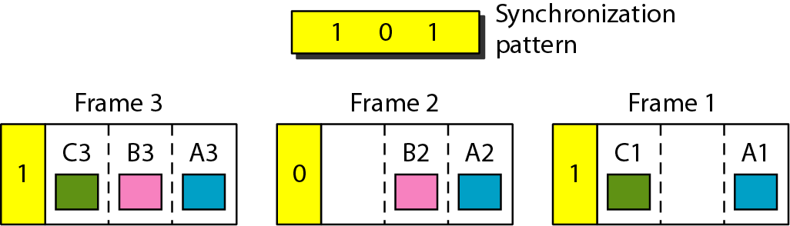
Frame Synchronizing
These bits, called framing bits, follow a pattern, frame to frame, that allows the demultiplexer to synchronize with the incoming stream so that it can separate the time slots accurately.
This synchronization information consists of 1 bit per frame, alternating between 0 and 1, as shown in Figure
58
Notes:
Data Communication

Slide 59
Synchronous TDM Applications
Some second-generation cellular telephone companies use synchronous TDM.
For example, the digital version of cellular telephony divides the available bandwidth into 30-kHz bands.
For each band, TDM is applied so that six users can share the band.
This means that each 30 kHz band is now made of six time slots, and the digitized voice signals of the users are inserted in the slots.
Using TDM, the number of telephone users in each area is now 6 times greater.
59
Notes:
Data Communication

Slide 60
Statistical Time-Division Multiplexing
In synchronous TDM, each input has a reserved slot in the output frame.
This can be inefficient if some input lines have no data to send.
In statistical time-division multiplexing, slots are dynamically allocated to improve bandwidth efficiency.
Only when an input line has a slot's worth of data to send is it given a slot in the output frame.
In statistical multiplexing, the number of slots in each frame is less than the number of input lines.
60
Notes:
Data Communication

Slide 61
Statistical Time-Division Multiplexing
The multiplexer checks each input line in round robin fashion;
It allocates a slot for an input line if the line has data to send; otherwise, it skips the line and checks the next line.
In the former, some slots are empty because the corresponding line does not have data to send.
In the latter, however, no slot is left empty as long as there are data to be sent by any input line.
61
Notes:
Data Communication

Slide 62
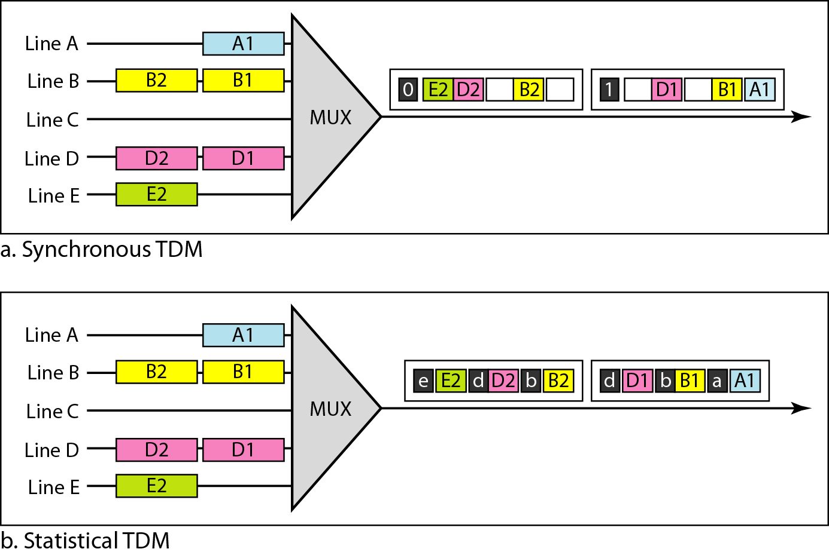
Statistical Time-Division Multiplexing
62
Notes:
Data Communication

Slide 63
Statistical TDM - Addressing
Figure also shows a major difference between slots in synchronous TDM and statistical TDM.
An output slot in synchronous TDM is totally occupied by data; in statistical TDM, a slot needs to carry data as well as the address of the destination.
In synchronous TDM, there is no need for addressing; synchronization and pre assigned relationships between the inputs and outputs serve as an address.
63
Notes:
Data Communication

Slide 64
Statistical TDM - Addressing
If the multiplexer and the demultiplexer are synchronized, this is guaranteed.
In statistical multiplexing, there is no fixed relationship between the inputs and outputs because there are no pre assigned or reserved slots.
We need to include the address of the receiver inside each slot to show where it is to be delivered.
The addressing in its simplest form can be n bits to define N different output lines with n =log₂ N.
For example, for eight different output lines, we need a 3-bit address.
64
Notes:
Data Communication

Slide 65
Slot Size
Since a slot carries both data and an address in statistical TDM, the ratio of the data size to address size must be reasonable to make transmission efficient.
For example, it would be inefficient to send 1 bit per slot as data when the address is 3 bits.
In statistical TDM, a block of data is usually many bytes while the address is just a few bytes.
65
Notes:
Data Communication

Slide 66
No Synchronization Bit
There is another difference between synchronous and statistical TDM, but this time it is at the frame level.
The frames in statistical TDM need not be synchronized, so we do not need synchronization bits.
66
Notes:
Data Communication

Slide 67
Bandwidth
In statistical TDM, the capacity of the link is normally less than the sum of the capacities of each channel.
The designers of statistical TDM define the capacity of the link based on the statistics of the load for each channel.
If on average only x percent of the input slots are filled, the capacity of the link reflects this.
Of course, during peak times, some slots need to wait.
67
Notes:
Data Communication

Slide 68
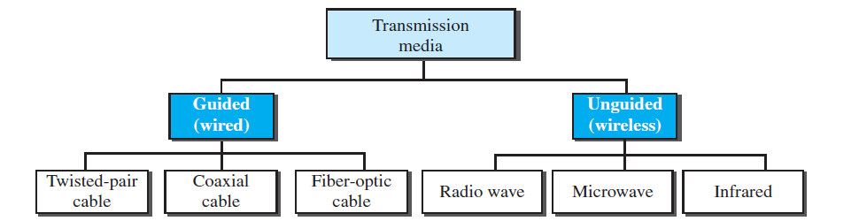
Transmission Media
Transmission media can be divided into two broad categories: guided and unguided.

Slide 69
Guided Media
Guided media, which are those that provide a conduit(channel) from one device to another, include
twisted-pair cable
coaxial cable
fiber-optic cable.

Slide 70
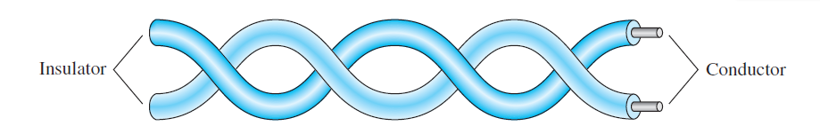
Twisted pair
A twisted pair consists of two copper conductors, each with its own plastic insulation, twisted together.
One of the wires is used to carry signals to the receiver, and the other is used only as a ground reference.
Interference (noise) and crosstalk may affect both wires and create unwanted signals.

Slide 71
Why twisted?
By twisting the pairs, a balance is maintained.
Suppose in one twist, one wire is closer to the noise source and the other is farther; in the next twist, the reverse is true.
Twisting makes it probable that both wires are equally affected by external influences (noise or crosstalk).
The receiver, which calculates the difference between the two, receives no unwanted signals. The unwanted signals are mostly canceled out.

Slide 72
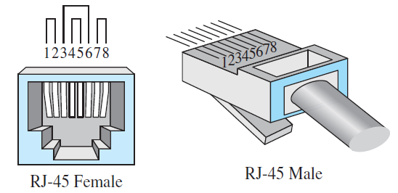
UTP Connector
The most common UTP connector is RJ45 (RJ stands for registered jack), as shown
The RJ45 is a keyed connector, meaning the connector can be inserted in only one way.

Slide 73
Applications
telephone lines to provide voice and data channels
DSL lines for high data rate connections

Slide 74
Coaxial Cable (CoAx)
Coaxial cable (or coax) carries signals of higher frequency ranges.
CoAx has a central core conductor of solid or stranded wire (usually copper) enclosed in an insulating sheath, which is, encased in an outer conductor of metal foil
The outer metallic wrapping serves both as a shield against noise and as the second conductor, which completes the circuit

Slide 75
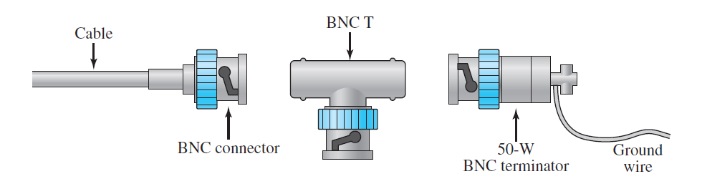
Bayonet Neill-Concelman (BNC) connector

Slide 76
Applications
Analog telephone networks carrying 10,000 voice signals
Digital telephone networks carrying digital data up to 600 Mbps

Slide 77
Fiber-Optic Cable
fiber-optic cable is made of glass or plastic and transmits signals in the form of light.
ray of light traveling through one substance suddenly enters another substance (of a different density), the ray changes direction
if the angle of incidence I (the angle the ray makes with the line perpendicular to the interface between the two substances) is less than the critical angle, the ray refracts and moves closer to the surface.
If the angle of incidence is equal to the critical angle, the light bends along the interface.
If the angle is greater than the critical angle, the ray reflects (makes a turn) and travels again in the denser substance.

Slide 78
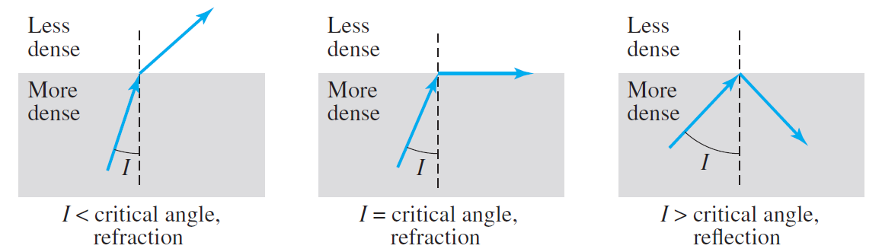

Slide 79
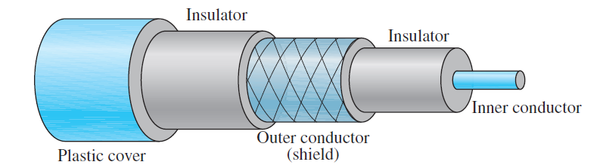
CoAx

Slide 80
Data-over-Cable Service Interface Specifications (DOCSIS®)
DOCSIS helps cable operators to provide internet services to consumers over existing cable TV systems
The DOCSIS standard is managed by CableLabs.
The other contributing companies include Cisco, Broadcom, Intel, Netgear, ARRIS, Texas Instruments

Slide 81
It allows transmission and reception of high bandwidth data over existing cable TV network or HFC (Hybrid Fiber Coaxial) network.
The first DOCSIS standard version 1.0 was developed in 1997.

Slide 82
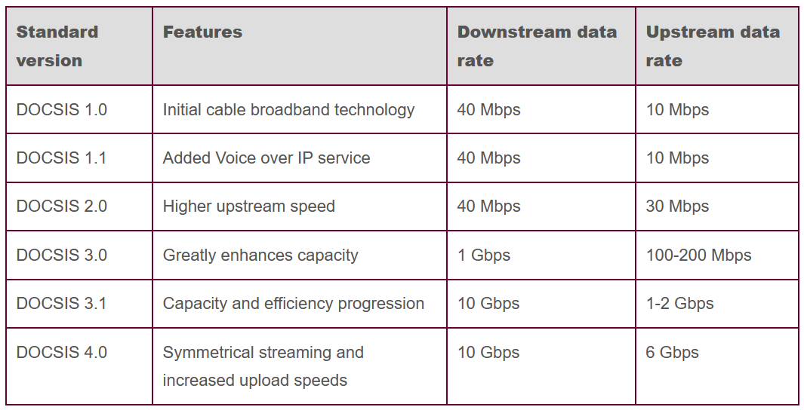
DOCSIS Evolution

Slide 83
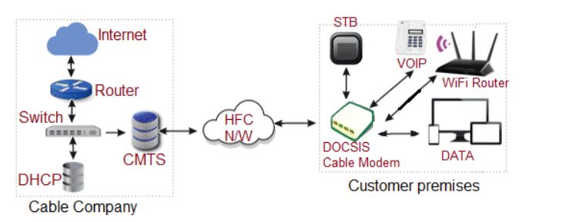
DOCSIS Architecture

Slide 84
There are three major elements of DOCSIS system viz. Cable modem, HFC network or cable TV network and CMTS.
DOCSIS network offers bi-directional flow of IP data between CM and CMTS
Cable network can be either all coaxial cable or Hybrid-Fiber/Coax (HFC) cable network

Slide 85




DOCSIS cable modem (CM)
It is the main interface between HFC network and Home network to bridge packets flowing between them.
The Cable modem allows connections with different customer premise equipments (CPEs) intending to access the internet.
Typical CPEs used at home or office premises are gateway, VoIP telephone, WiFi Modem or router, Personal computer and Set Top Box (STB).
CPE can either be embedded with CM in single device or both are separated into standalone devices as shown in the figure-1.
WiFi modem or router takes care of providing simultaneous internet access to desktop, mobile, laptop, tablet etc. using wifi signals. CPEs support IPv4, IPv6 or both.

Slide 86
CMTS
CMTS stands for Cable Modem Termination System
It is the main element located at cable operator side.
DOCSIS standard defines messages and data types exchanged between CMTS and CM
connects cable operator back office and core network to HFC network.
The main function of CMTS is to forward packets between HFC and back office.
forwards packets between upstream and downstream channels on HFC network.
Here downstream refers to data flow from cable company to customer premises equipment where as upstream refers to data flow from CM (i.e. cable modem) to cable company (i.e. CMTS side).

Slide 87
Advantages of DOCSIS 3.1
backward compatible
This makes it Cost effective and easy to install.
new certificate based enhanced security feature. This prevents malicious firmware being downloaded to cable modem
reduces packet latency over cable network by improvement in packet queueing mechanism. Better VoIP calls and online gaming.
supports light sleep modes during IDLE period. This reduces overall power consumption

Slide 88
Advantages of DOCSIS 3.1
DOCSIS 3.1 allocates higher frequency spectrum compare to its predecessor DOCSIS 3.0. DOCSIS 3.0 uses frequency band from 5 MHz to 65 MHz for upstream traffic and from 85 MHz to 1002 MHz for downstream traffic.
uses frequency band from 5 MHz to 204 MHz for upstream traffic and from 252 MHz to 1788 MHz for downstream traffic.

